Slide 1

Module 1: Introduction to Programming, Variables, Operators, and I/O
CSC 6003 – Programming Foundations

Slide 2
Week 1 Goals
Describe the fundamental programming and computer science terminology
Explain the basic structure of a Python program
Be able to write, compile, execute and debug simple Python programs that print messages to the screen (e.g. “Hello World!”)
Assess the basics of the software development process
Describe variables and data types

Slide 3
Programming
Breaking down a large problem into smaller pieces until simple enough to be performed by instructions provided by computer
Sequence of instructions = program
Key types of instructions:
Input
Output
Math
Decisions
Repetition

Slide 4
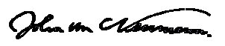
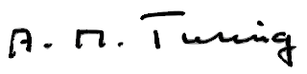
The Universal Machine
“If people do not believe that mathematics is simple, it is only because they do not realize how complicated life is.”
“The idea behind digital computers may be explained by saying that these machines are intended to carry out any operations which could be done by a human computer.”

Slide 5
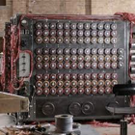
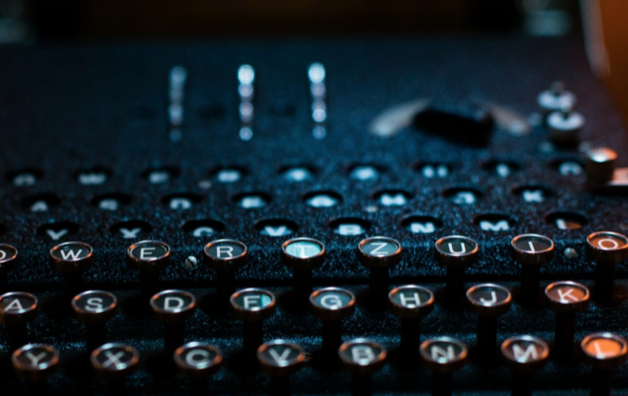
From Machine to Universal Machine
Turing Machine (math to CS)
A state (tape)
A series of commands that may:
Get some input to the tape
Move the tape
Read the tape
Decide what to do next
Print into the tape
Alan Turing - theory and practice
Publications in 1920’s
Call to duty during WWII
Bletchley Park team to decode Enigma
vs.
Source: https://bletchleypark.org.uk/

Slide 6
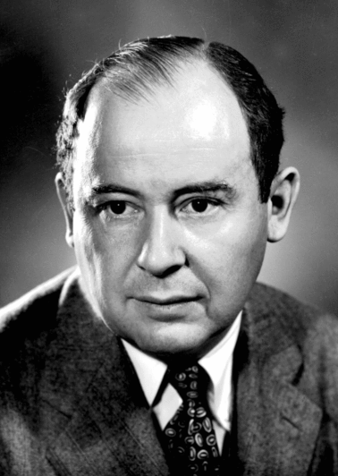
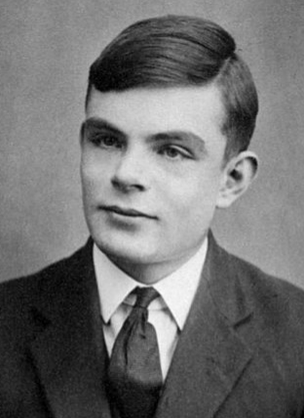
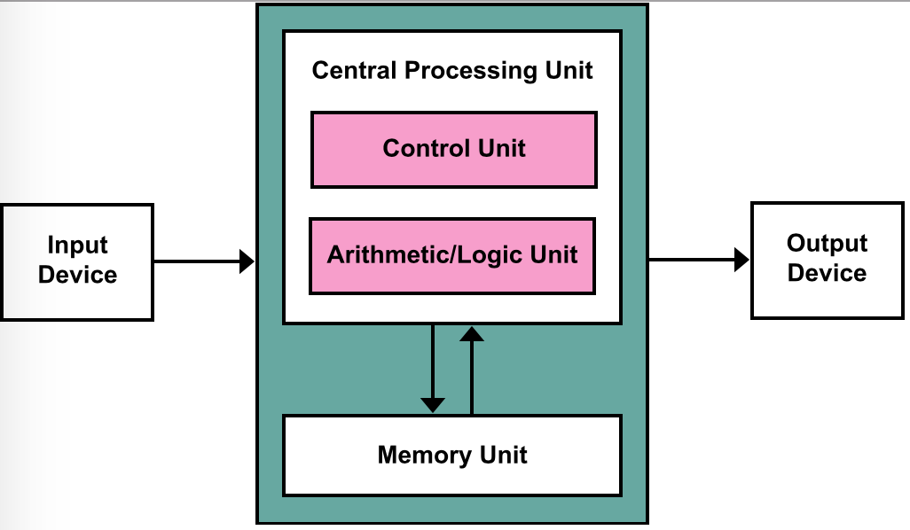
John Von Neumann Architecture
Stored Program
Instructions and data stored in a memory unit
A Central Processing Unit that fetches commands and executes them:
Getting input
To store new values
Producing output
John Von Neumann
1903 - 1940 - 1957
Alan Turing
1912 - 1928 - 1954
Source: https://en.wikipedia.org/wiki/Von_Neumann_architecture

Slide 7
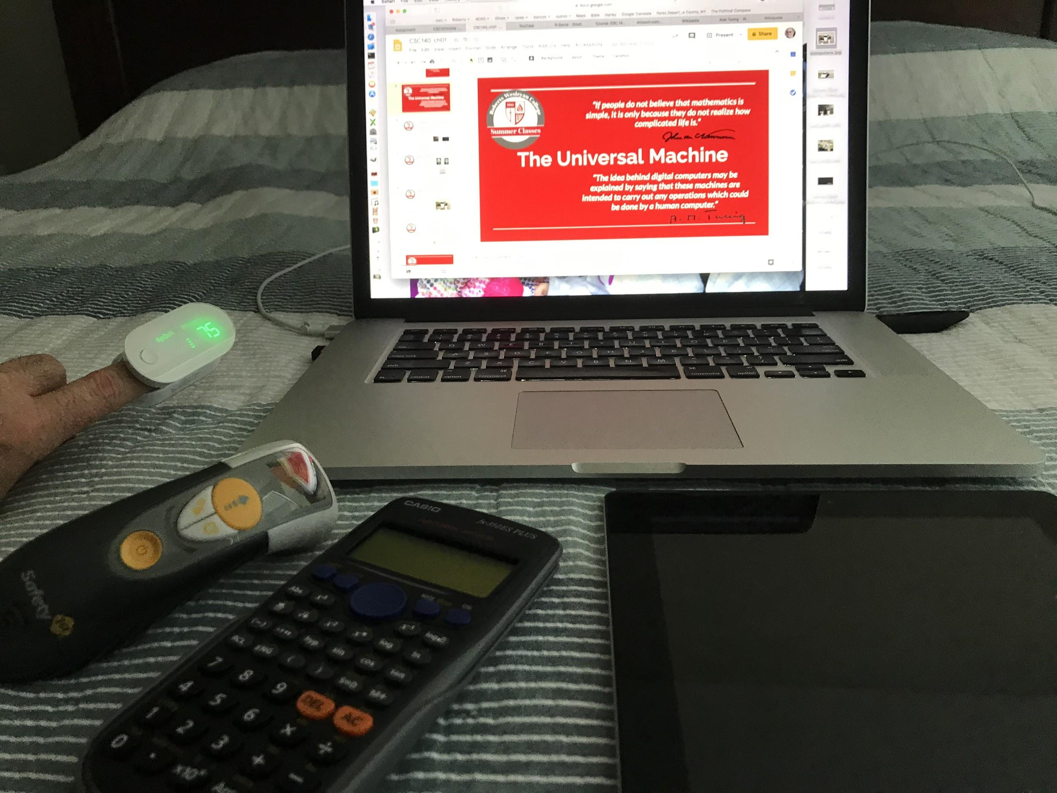
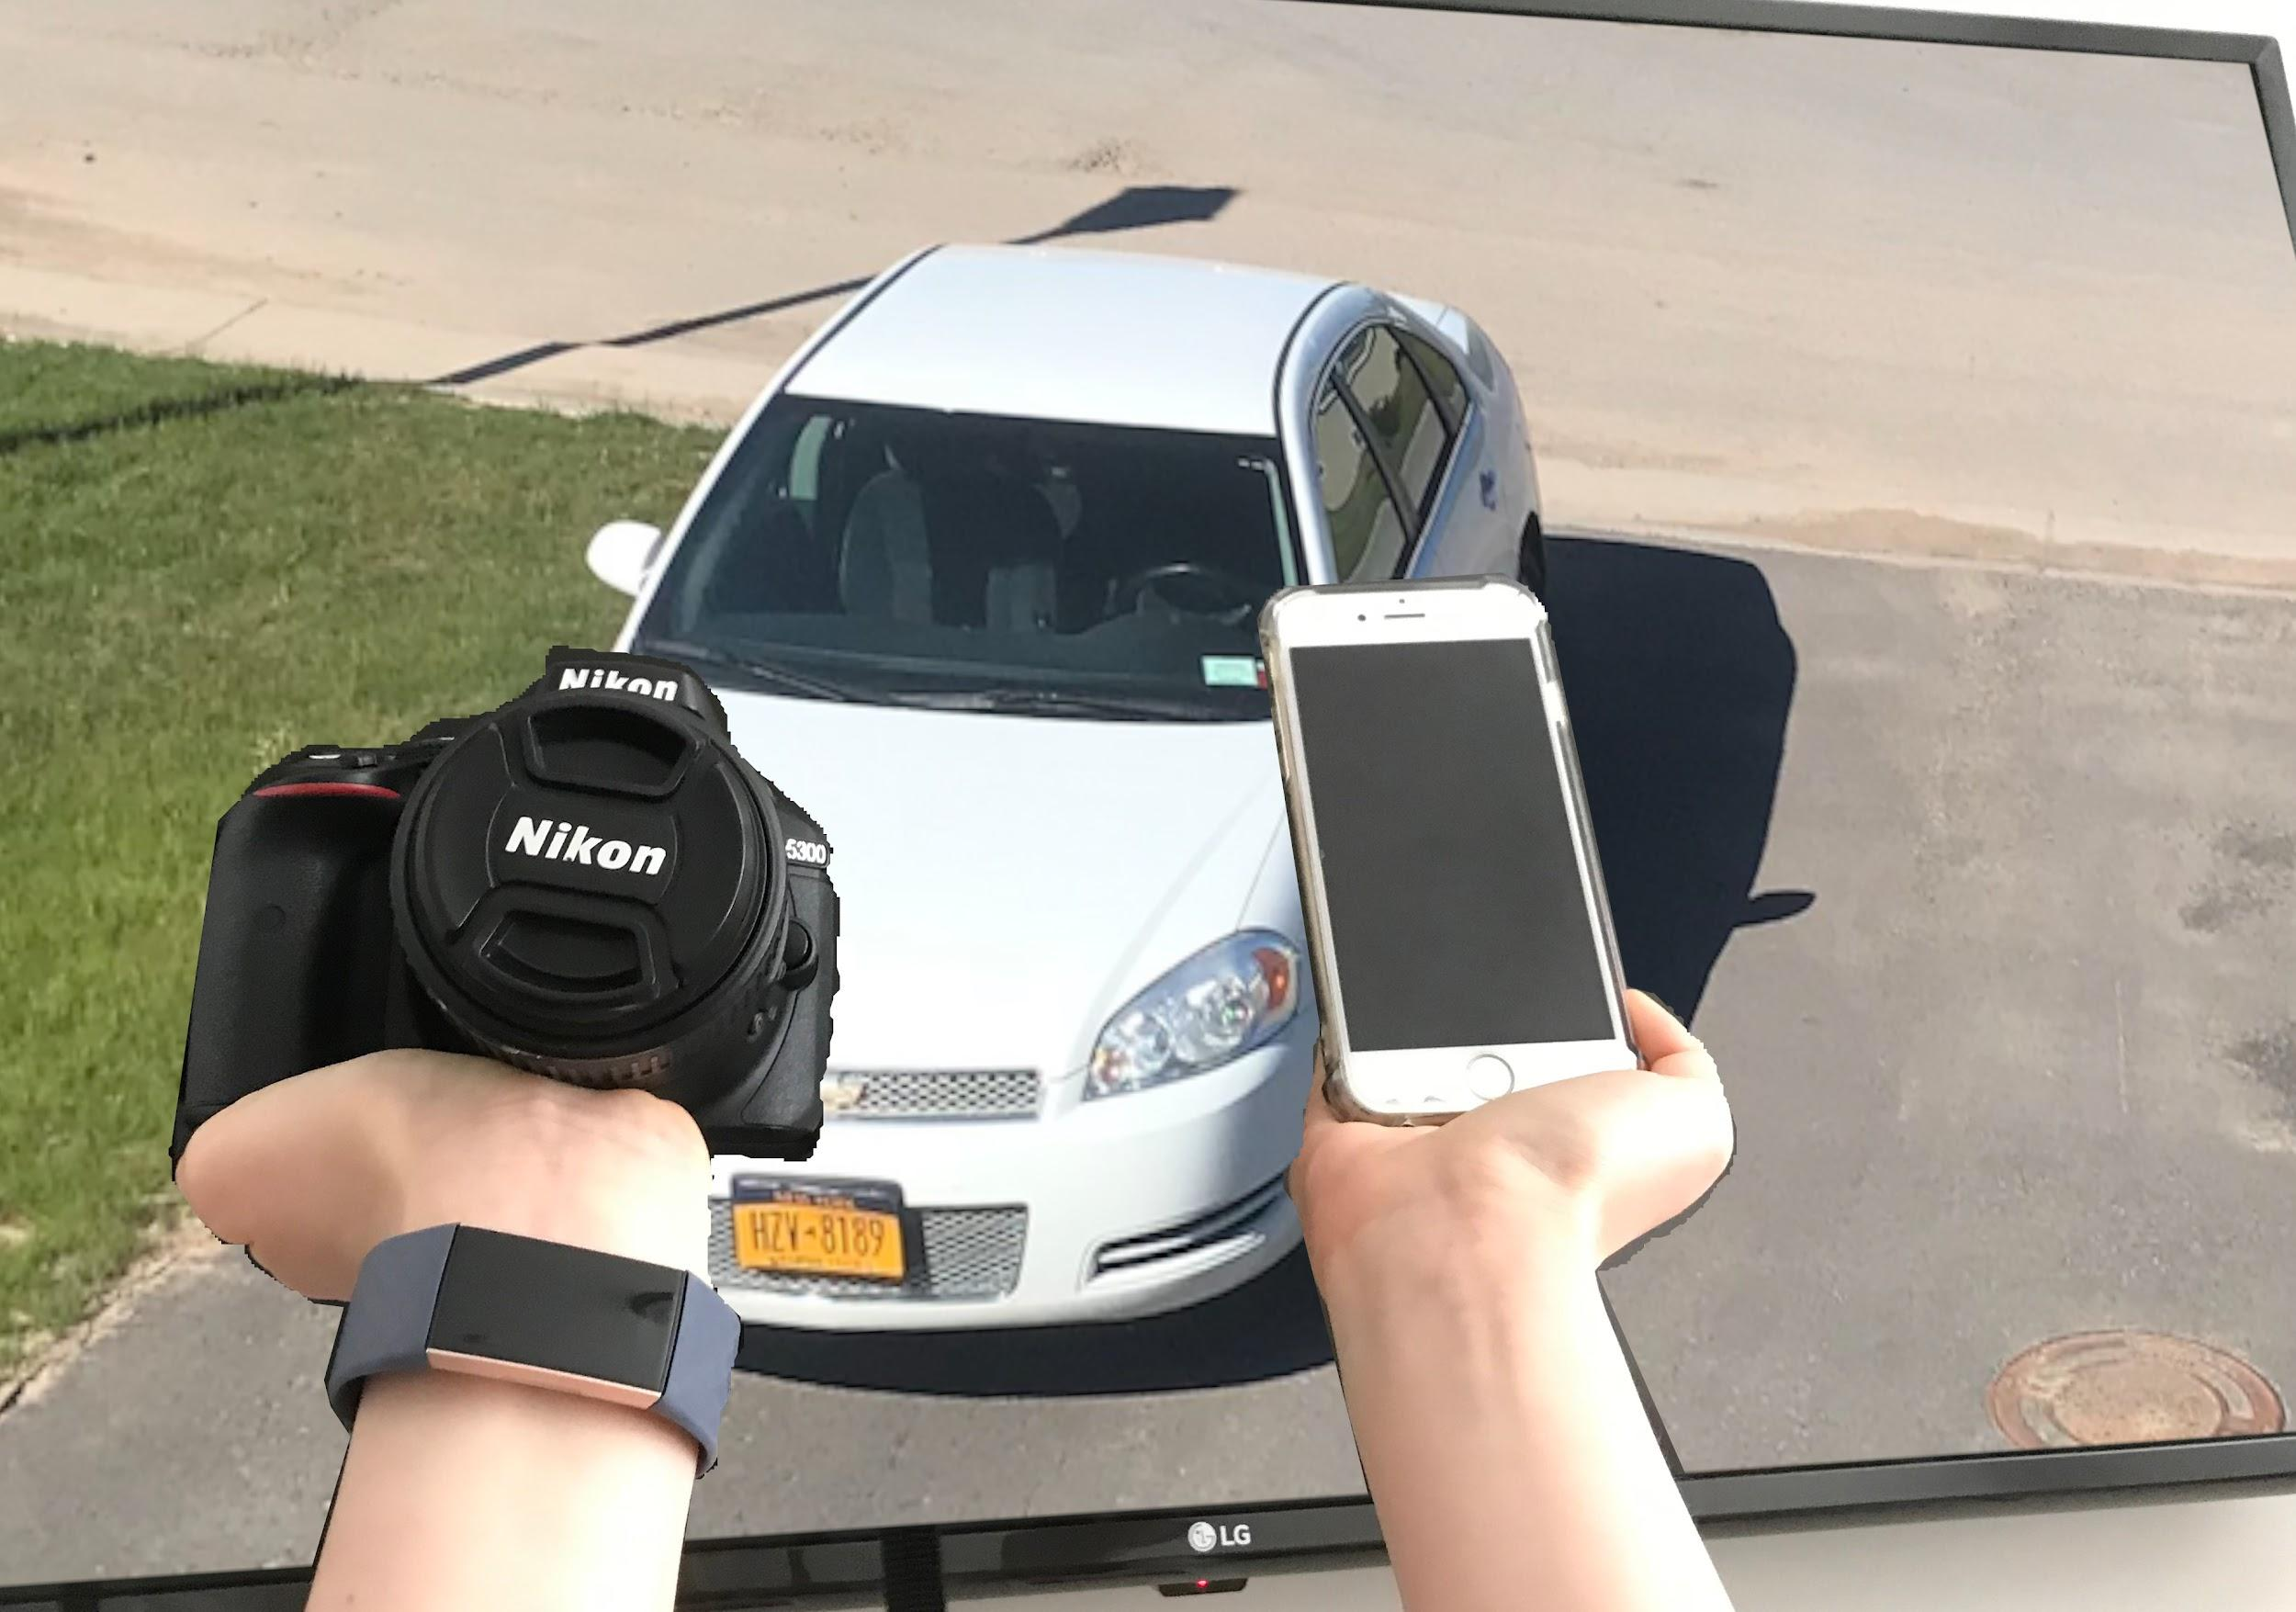
What are Computers Now?
Ubiquitous
Most of things are computers right now
How many computers appear in this slide?
0
1
2
3
4
5
6
7
8
9

Slide 8
Algorithms
“Indicate precisely what you mean to say”
The Beatles - When I’m 64
“Tell me what you want, what you really, really want”
Spice Girls - Wannabe

Slide 9
Algorithms
Sequence of steps on how to solve a problem
Different algorithms can be used to solve same problem
Each algorithm may have its own tradeoffs (e.g. faster / slower, uses more / less memory, etc.)
Like a recipe – many ways to make the same food, but maybe not exact same ingredients or steps
Computer Science = Science of algorithms
Designing algorithms and writing code can be difficult and error-prone
These programming errors are called bugs
Notes:
Bake a cake

Slide 10
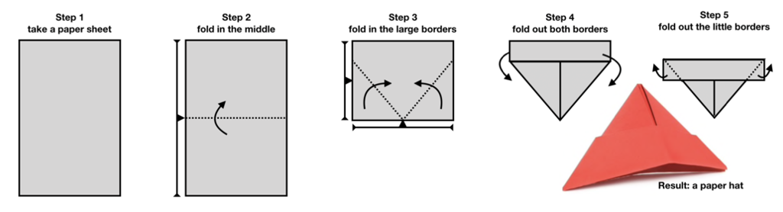
Can you follow commands?
Pick a piece of paper
Execute the five steps below paying really attention
Really do it, only go on with the presentation when you have the paper hat done!

Slide 11
That was a Paper Hat algorithm!
Dangers in this practical exercise
You may know it already differently, and that may prevent you to exactly follow the commands
Computers doesn’t have this “disadvantage”
The commands, even though graphically depicted, are not formally defined
You need to know the “language”
You may not be able to manual activities
Computers (and machines in general) are ok with that

Slide 12
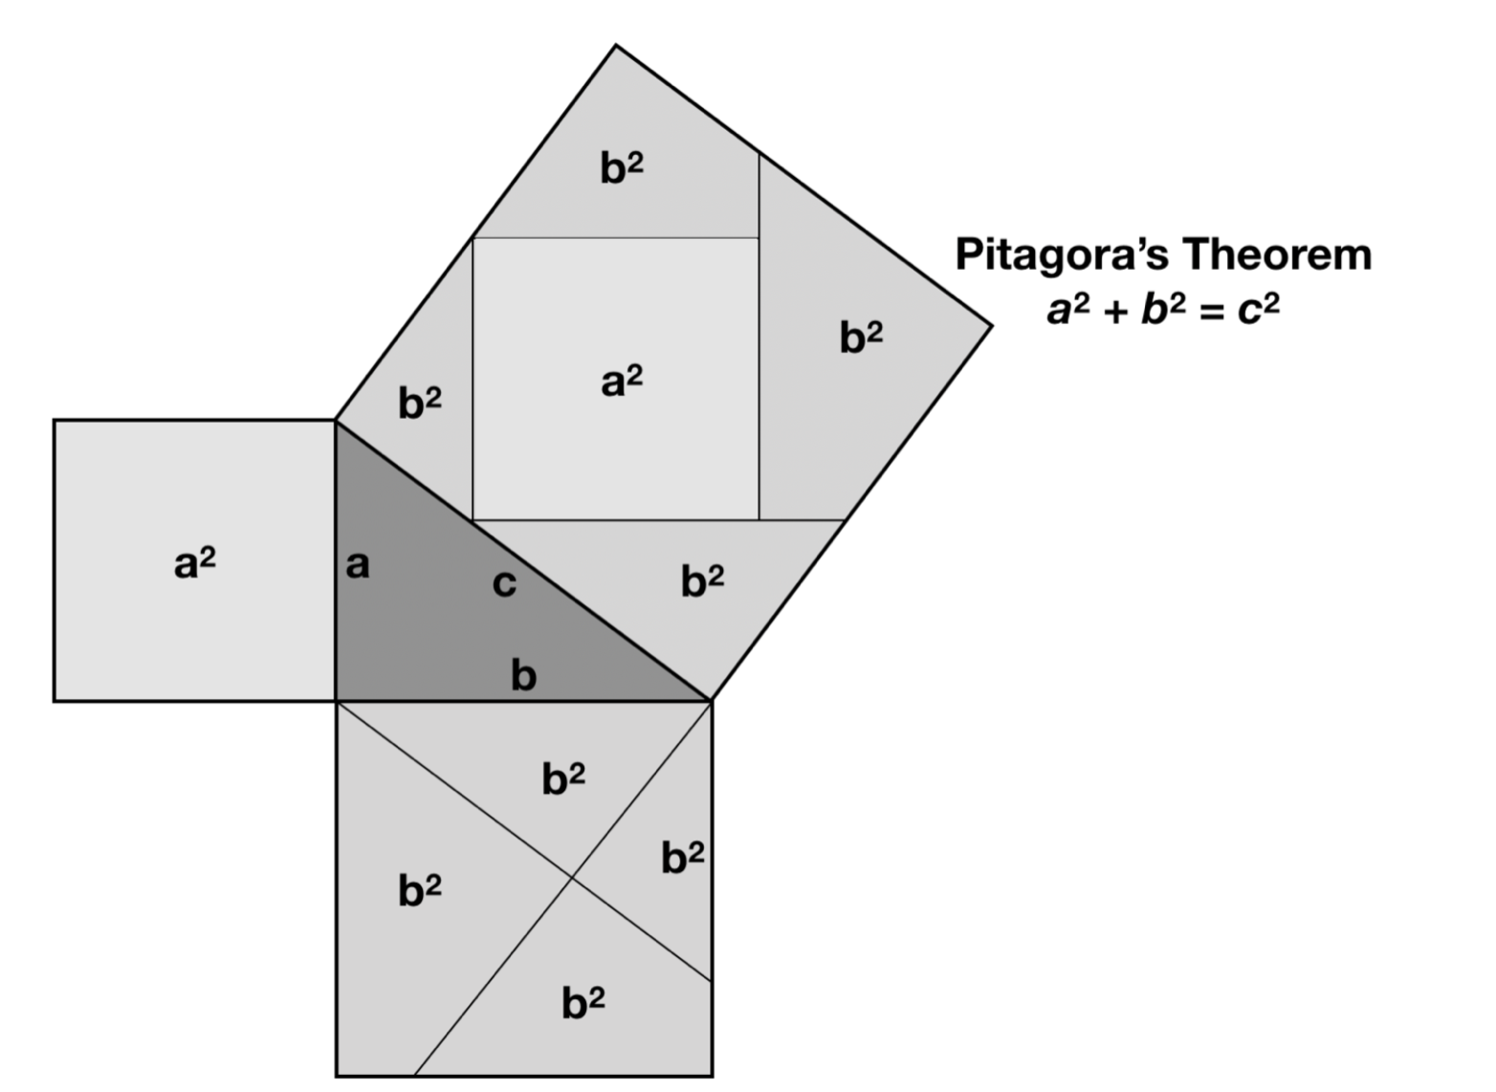
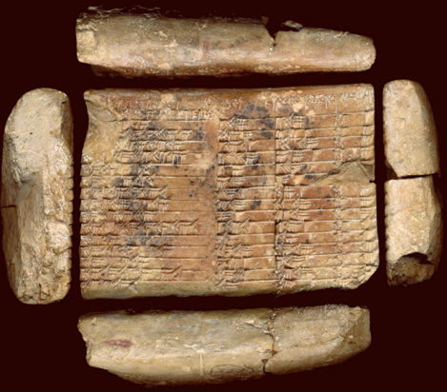
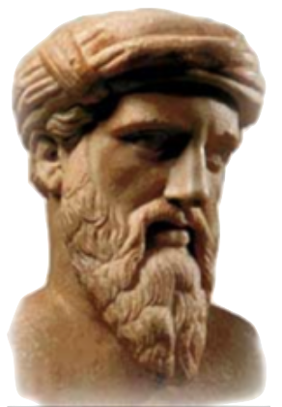
Pythagoras’ Theorem
Pythagoras’
Approx. 1800 BC - Babylon (currently Iraq)
Source: https://en.wikipedia.org/wiki/Plimpton_322
Approx. 500 BC - Kroton (currently Italy)
Source: https://en.wikipedia.org/wiki/Pythagoras

Slide 13
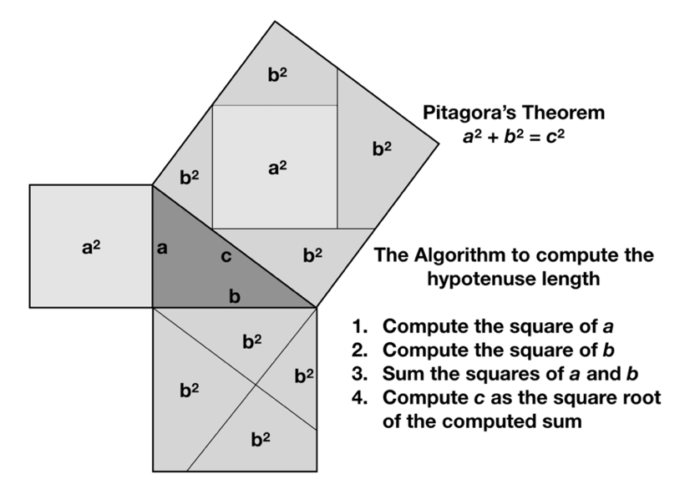
Can you give commands?
Pythagoras’
Write an algorithm to compute the hypotenuse length (c) giving the length of the catheti (a and b) are known

Slide 14
This is one possible algorithm
Pythagoras’

Slide 15

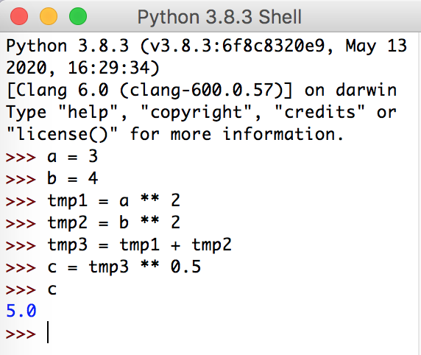
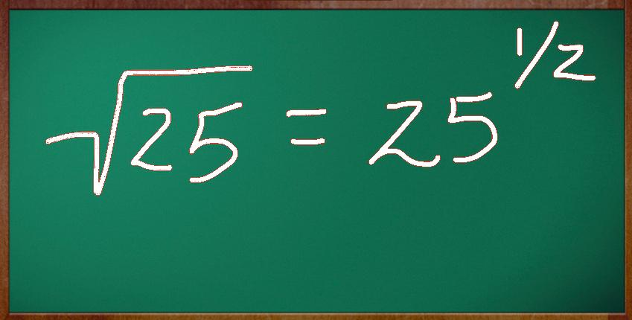
Pythagoras’ algorithm without ambiguity
Mathematical expressions
Compute the square of a
tmp1 = a ** 2
Compute the square of b
tmp2 = b ** 2
Sum the squares of a and b
tmp3 = tmp1 + tmp2
Compute c as the square root of the computed sum
c = tmp3 ** 0.5
Power: x^{y} is x ** y

Slide 16
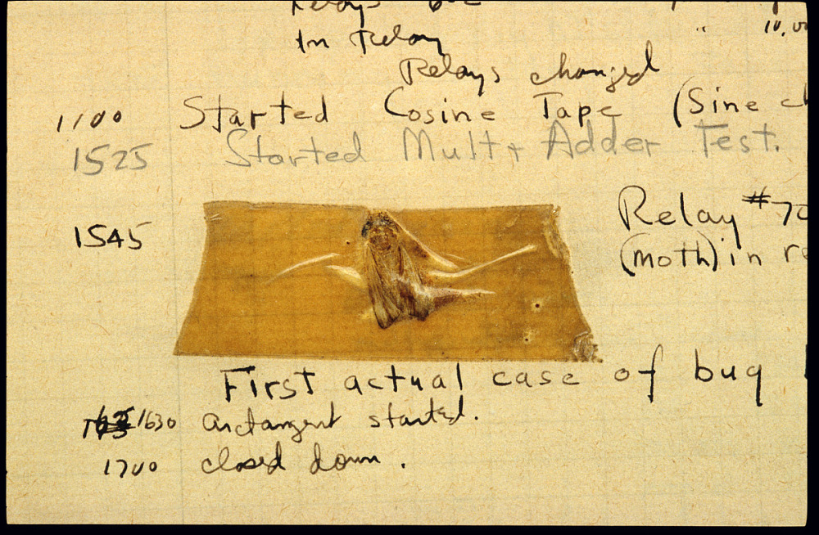
Bugs
Why do we call an error a bug?
Origin goes back to Grace Hopper
Computer pioneer
US naval officer
While working on Mark II computer at Harvard University in 1946, she found that a moth had disrupted the electronics and produced errors in the program
More info: https://ei.cs.vt.edu/~history/Hopper.Danis.html
Notes:
Actual bug taped to journal

Slide 17
Debugging
Programming is done by a human and is error prone
Debugging = Process of troubleshooting a computer program and removing errors
Example:
The program compiles and runs without an error but result is not as expected
E.g. an adding program that says 2 + 2 = 7
Notes:
Explain errors next

Slide 18
Debugging
Can be challenging
Like scientific method
Create hypothesis of problem
Test hypothesis by making a change
Analyze the result of change
Accept change or reject change and repeat process
We will explore testing and debugging techniques throughout course

Slide 19
Programming Languages
High-level languages
Java, C, C++, C#, Python, Ruby, JavaScript
Combination of keywords and special syntax
Easier for humans to understand, but computer cannot understand
Portable – can run on different computer platforms/architectures with little or no changes
Low-level languages
Also called assembly language
High-level languages are translated to low-level languages by an interpreter
Hardware specific
Machine language
Binary code (0’s and 1’s)
Low-level language are translated to machine language by an assembler
Hardware specific
Directly understood by computer

Slide 20
Translating High-level languages
Two ways to execute a program in a high-level language
Interpreter – reads a piece of program written in high-level language and translates to machine language one step at a time
Compiler – reads the entire program written in a high-level language and translates completely to machine language, then executes it.

Slide 21
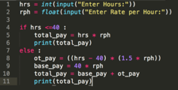

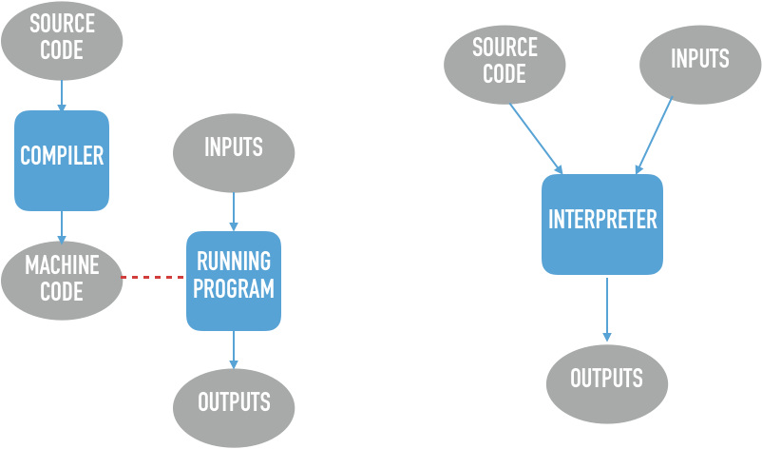
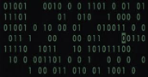

Compiled or Interpreted

Slide 22
Basic Elements of Programs
Appendix A of your Textbook has a quick reference
Complete Information at
https://docs.python.org/3/

Slide 23
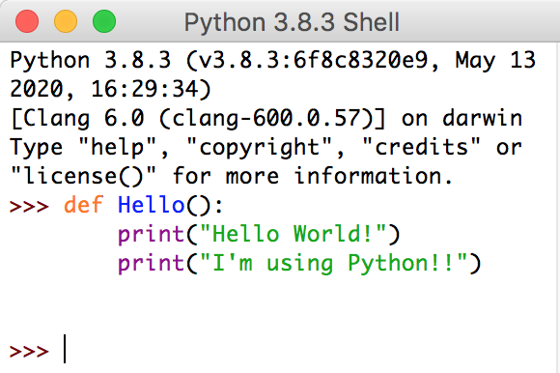
Functions
Wrap-up commands (more details in Chapter 6)
def command
Function name, optionally parameters, and a colon
Commands indented
def <name>():
<command>
<command>
...
To call a function named <name>: <name>()

Slide 24
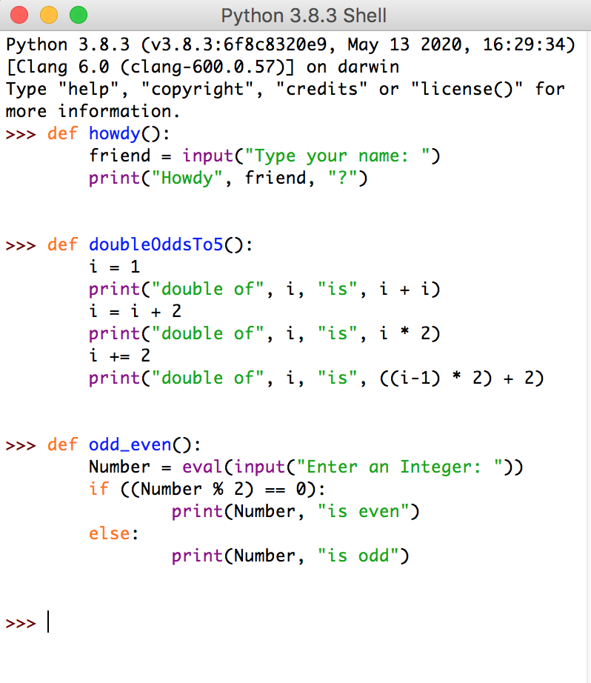
Names for Functions (and Variables)
Can contain letters, digits and underscore
Can’t start with digits
They are case sensitive
Can’t use reserved words
Good Practices
Say what you mean
Not too long, not too short
Avoid built-in functions
Style
Verbs for functions
Nouns for variables
UPPERCASE, UpperCase, lowerCase, and lower_case

Slide 25
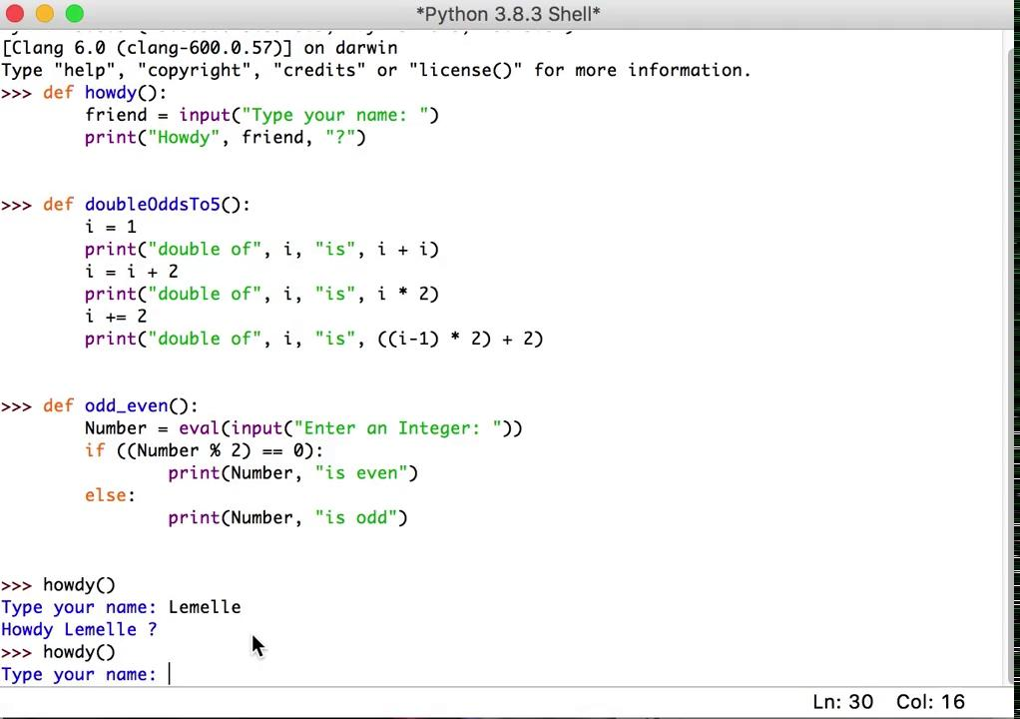
Function howdy()
Open your IDLE
Create a function
def
Output a message
print()
Run the function

Slide 26


Reserved Words in Python 3
Never use it as names
False, None, True, and, not, or
if, elif, else
for, in, break, continue, while
class, del, is, global, nonlocal, lambda
try, except, raise, finally, assert
def, from, import, as, with, pass, return, yield
Avoid built-in (common) functions, as such:
print(), abs(), round(), min(), max(), list(), sum(), eval(), len(), sqrt(), str(), chr(), open(), format(), slice(), input()
Full list at: https://docs.python.org/3/library/functions.html

Slide 27
Expressions - Numbers, Strings, and Sequences
Operators | Meaning | Example
+ | Addition Concatenation | 2+3 becomes 5 “RW”+”C” becomes “RWC”
- | Subtraction | 43 - 6 becomes 37
* | Product Replication | 4 * 6 becomes 24 “ab” * 3 becomes “ababab”
/ | Division | 13 / 4 becomes 3.25
% | Remainder of the division | 13 % 4 becomes 1
** | Exponentiation | 2 ** 3 becomes 8

Slide 28
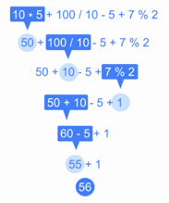
Expressions
Precedence
Mathematical
Power (**) over all
Multiplication (*), Division (/), and Remainder (%)
Addition (+) and Subtraction (-)
Parenthesis overrule mathematical precedence
How much is 2 + 2 * 5 ** 2 ?
How much is (2 + 2) * 5 ** 2 ?
How much is 1 + 6 * 8 / 3 + 4 - 1 - 3 ?
How much is “abc” + “de” * 2 ?
How much is 15 % 2 * 3 ?

Slide 29
Expressions - solution
Precedence
Mathematical
Power (**) over all
Multiplication (*), Division (/), and Remainder (%)
Addition (+) and Subtraction (-)
Parenthesis overrule mathematical precedence
How much is 2 + 2 * 5 ** 2 ?
How much is (2 + 2) * 5 ** 2 ?
How much is 1 + 6 * 8 / 3 + 4 - 1 - 3 ?
How much is “abc” + “de” * 2 ?
How much is 15 % 2 * 3 ?
52
100
17
“abcdede”
3

Slide 30
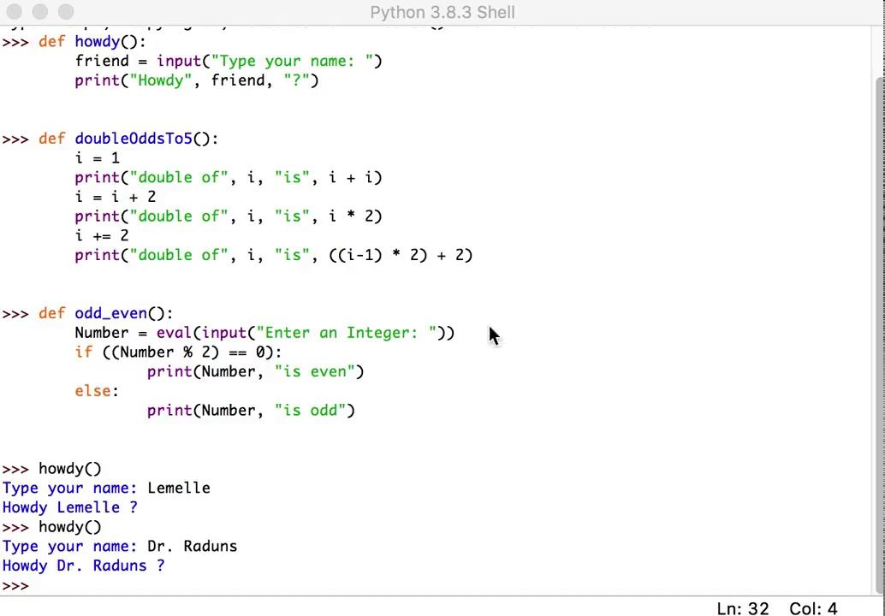
Function doubleOddsTo5()
Open your IDLE
Mathematical operations
= + - *
+=
Output a message

Slide 31
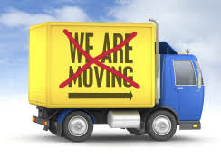
Assign statements
Single variable
<variable> = <expression>
Multiple variables
<variable₁, …, variable_{n}> = <expression₁, …, expression_{n}>
x = 4
y = 5
z = x + y
w = x * y
print(z, w)
9 20
x = 4
y = 5
x = y
y = x
print(x, y)
5 5
x = 4
y = 5
x, y = y, x
print(x, y)
5 4
x, y, z = 0, 0, 0
x, y, z = \ 10, x+5, y+3
print(x, y, z)
10 5 3

Slide 32
Output statement
Print command (more details in Chapter 8)
print(<expression>, <expression>, ..., <expression>)
print(<expression>, <expression>, ..., <expression>, end=“\n”)
print(<expression>, <expression>, ..., <expression>, end=<string>)
>>> print(“The number of Spiderman movies is”, 2+3+2+1)
>>> The number of Spiderman movies is 8
>>> def printSpiderman_movies():
print(“The number of Spiderman movies is”, end=“ ”)
print(2+3+2+1)
>>> printSpiderman_movies()
>>> The number of Spiderman movies is 8

Slide 33
Input statements
Input command
input(<string>)
It returns a string
Eval command
eval(<string>)
It returns a number
>>> myString = input(“Enter your name: ”)
>>> Enter your name: John Smith
>>> myNumber = eval(input(“Enter your age: ”))
>>> Enter your age: 55
>>> myNumber = eval(input(“Enter your age: ”))
>>> Enter your age: 2019-1964
myString = “John Smith”
myNumber = 55
myNumber = 55

Slide 34
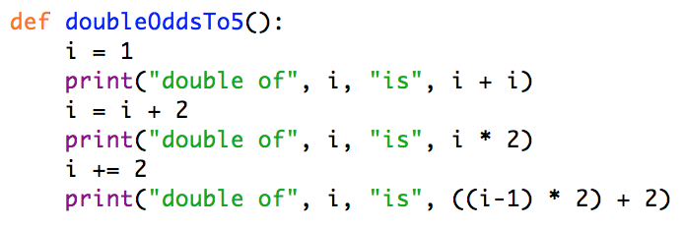

Definite Loops
for loop (more details in Chapters 5 and 8)
for <variable> in <sequence>:
<body>
A repetitive action executing the <body> iteratively
>>> for i in [1,3,5]:
print(“double of”, i, “is”, i*2)
>>> double of 1 is 2
double of 3 is 6
double of 5 is 10

Slide 35
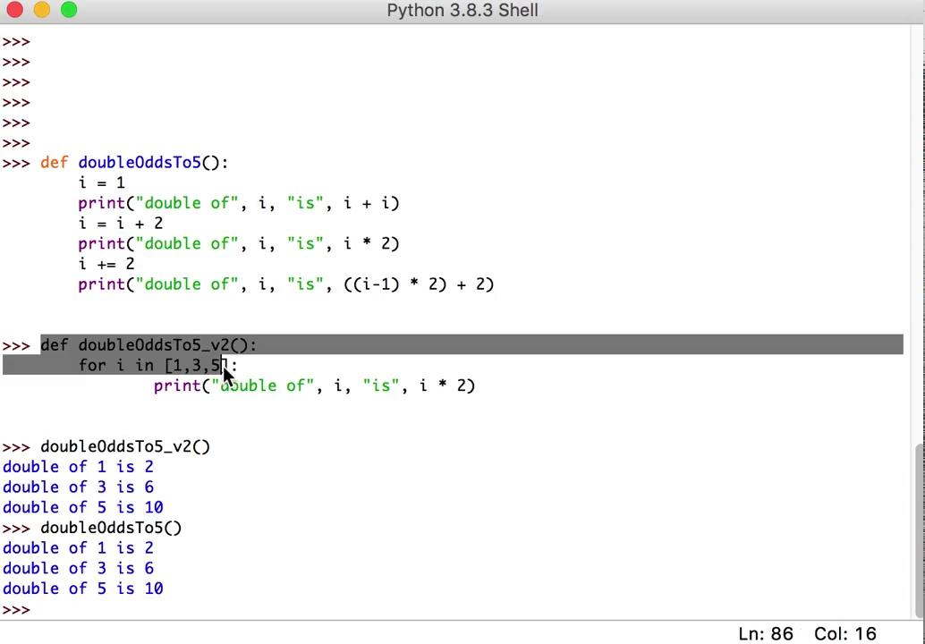
Function doubleOddsTo5()version 2
Open your IDLE
A for loop
A sequence
Mathematical operations
Output a message

Slide 36

Basic Conditions
if-else command (more details in Chapter 7)
if <condition>:
<body>
else:
<body>
>>> n = eval(input(“Enter the number: ”))
>>> if (n >= 0):
print(n, “is non negative”)
else:
print(n, “is negative”)
>>> Enter the number: 23
23 is non negative
>>> Enter the number: -18
-18 is negative

Slide 37
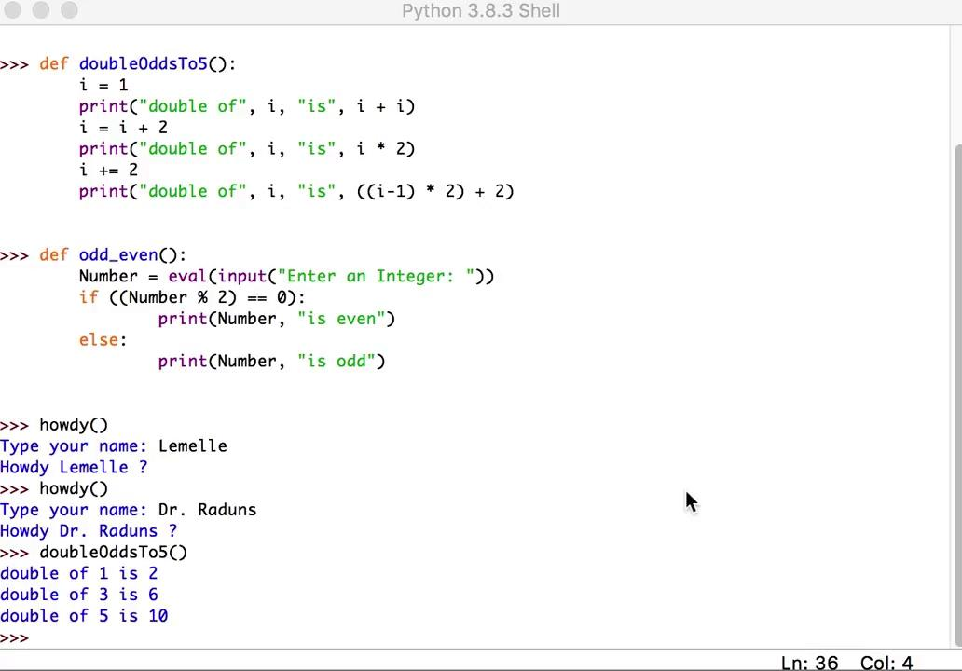
Function odd_even()
Open your IDLE
Input statement
input and eval
Basic condition
if - else
Output statement

Slide 38
Software
Development Process
“Rien ne sert de courir si l'on n'est pas pressé.”
Pierre Dac
(There's no point in running if you're not in a hurry.)

Slide 39

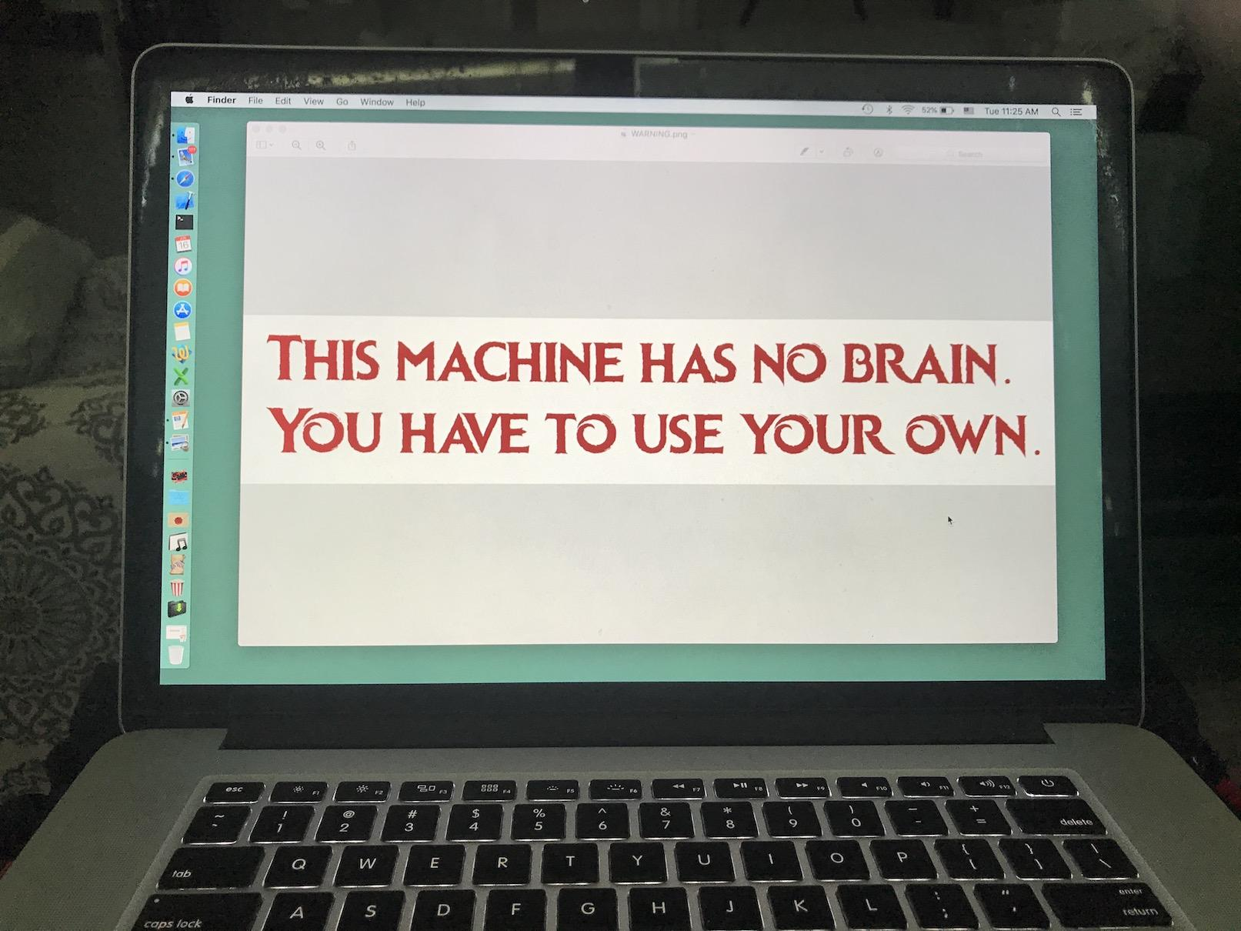
Software Development Process
Six steps (more details in Chapter 9 and 12)
Analyze the problem
Determine specifications
Create a design
Implement the design
Test/Debug the program
Maintain the program
Now with me: two examples - Later on your own: Sec. 2.7

Slide 40
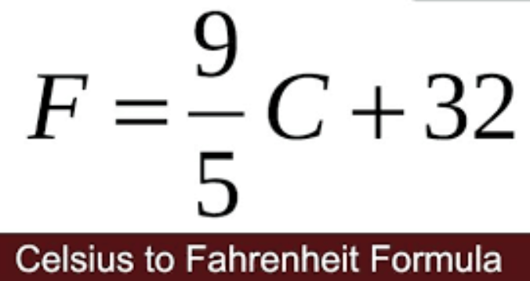
Temperature Converter Example
Create a program that converts F⁰ to C⁰
Analyze the problem - I know Fahrenheit and Celsius
Determine specifications - The formula
Create a design - Input F⁰, compute value, output C⁰
Implement the design - A Python program
Test/Debug the program - A working Python program
Maintain the program - Visit later if changes are needed
Try it yourself before watching the solution

Slide 41
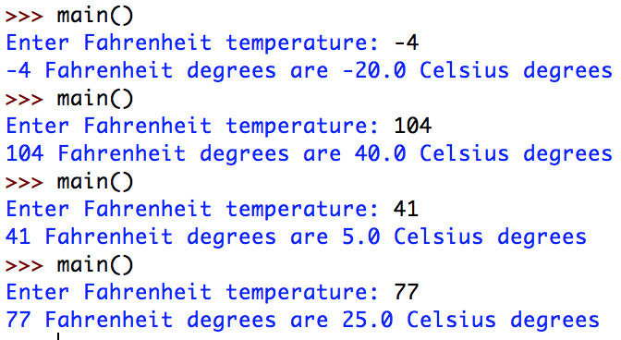
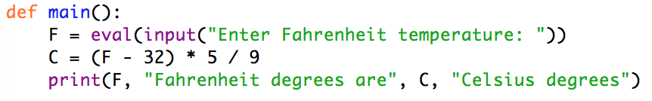
Temperature Converter Example
Create the Design
Considering
Then C = (F - 32) * 5 / 9
Implement the Design
Input the Fahrenheit
Compute Celsius
Output Celsius
Test/Debug
Try yourself now to implement C⁰ to F⁰

Slide 42
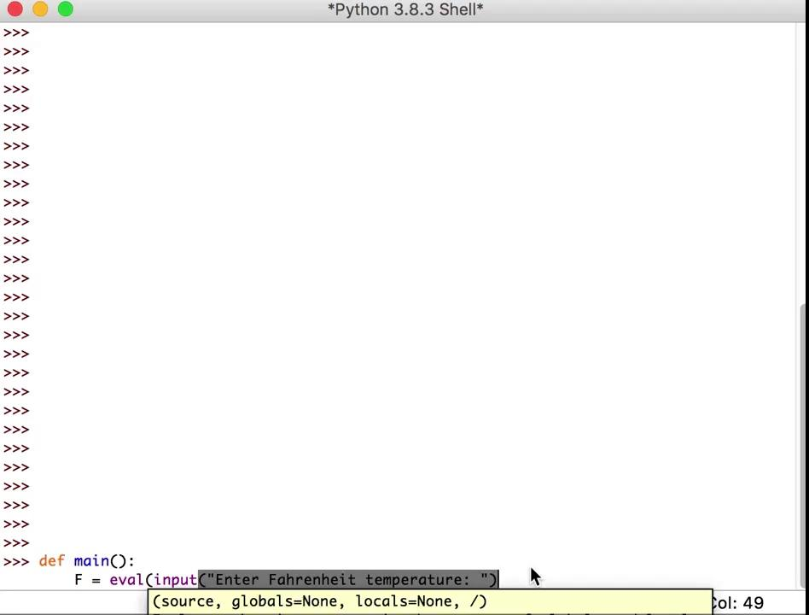
Temperature Converter
Algorithm
Input the Fahrenheit
Compute Celsius
Output Celsius

Slide 43
Is it cold in Canada today?
Ask a Canadian what is cold, then given F⁰ decide it
Analyze the problem - I know Fahrenheit and Celsius
Determine specifications - The formula
Create a design - Ask threshold and temp, convert, decide
Implement the design - A Python program
Test/Debug the program - A working Python program
Maintain the program - Visit later if changes are needed
Try it yourself before watching the solution

Slide 44
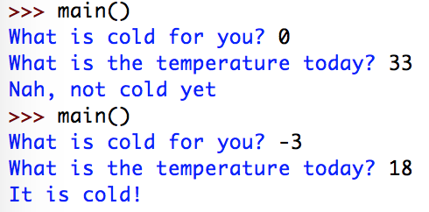
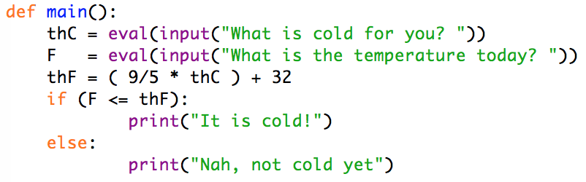
Is it cold in Canada today?
Create the Design
Considering
Implement the Design
Ask C⁰ threshold
Ask F⁰ temperature
Convert threshold to F⁰
Make a comparison
Test/Debug

Slide 45
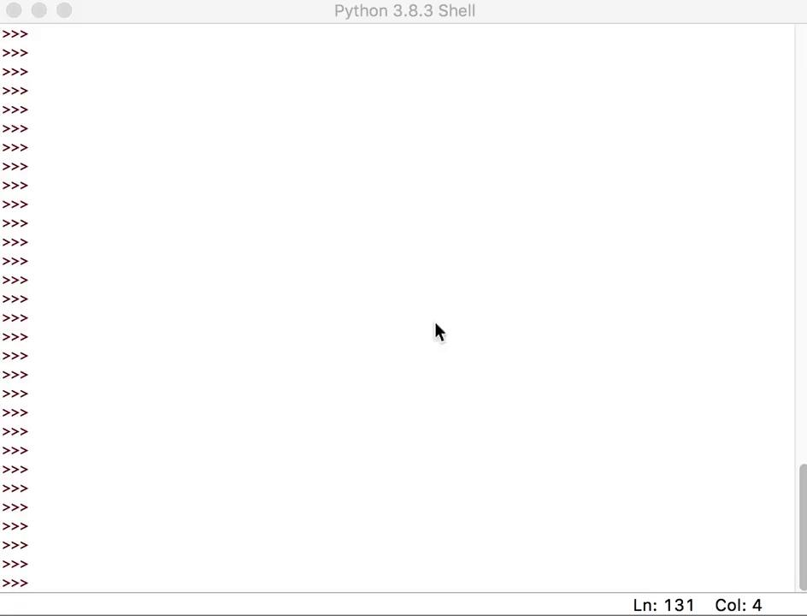
Is it cold in Canada today?
Algorithm
Ask C⁰ threshold
Ask F⁰ temperature
Convert th. to F⁰
Make a comparison

Slide 46
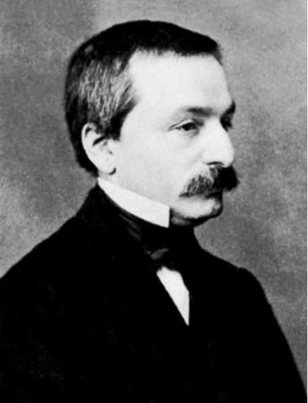
Numeric Data Types
Leopold Kronecker
1823 - 1865 - 1891
“Die ganzen Zahlen hat der liebe Gott gemacht, alles andere ist Menschenwerk.”
Leopold Kronecker
(God made the Integers, all the rest is the work of man.)

Slide 47
Numbers in Math and in Python
Mathematically
Natural Numbers
1, 2, 3, 4, …
Whole Numbers
Naturals, 0
Integers
Whole Numbers, -1, -2, …
Rational Numbers
Fractions of Integers
Irrational Numbers
pi, e, square root of 2, …
Reals
Rationals and Irrationals
int
All Integers
Binary extensible representation
float
All Reals
Binary partially extensible floating point (scientific notation-like representation)
Precision issues
100𝝅 = 3.141592653E+02
Complex Numbers have to be built

Slide 48
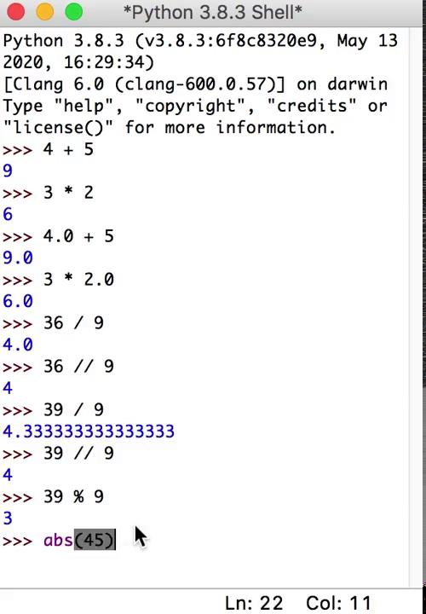
Int and Float Operators
int -> int float -> float
+ | addition
- | subtraction
* | product
/ | division
** | power
// | integer division
% | remainder
abs() | absolute value
Already seen
+ - * / ** %
Novelty
// always int
abs() always non neg.

Slide 49
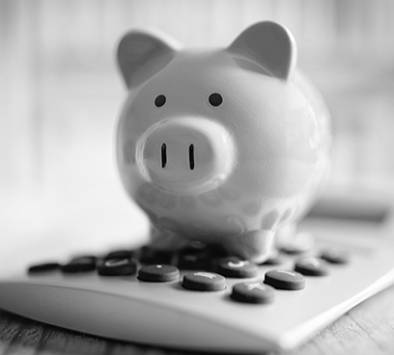
Piggy Bank Example v.1
Change Counter
Do a program that asks how many of each coin type you have and sum up how much dollars and cents you have
Algorithm
Greets
Asks count of each coin
Sums up
Outputs the result

Slide 50
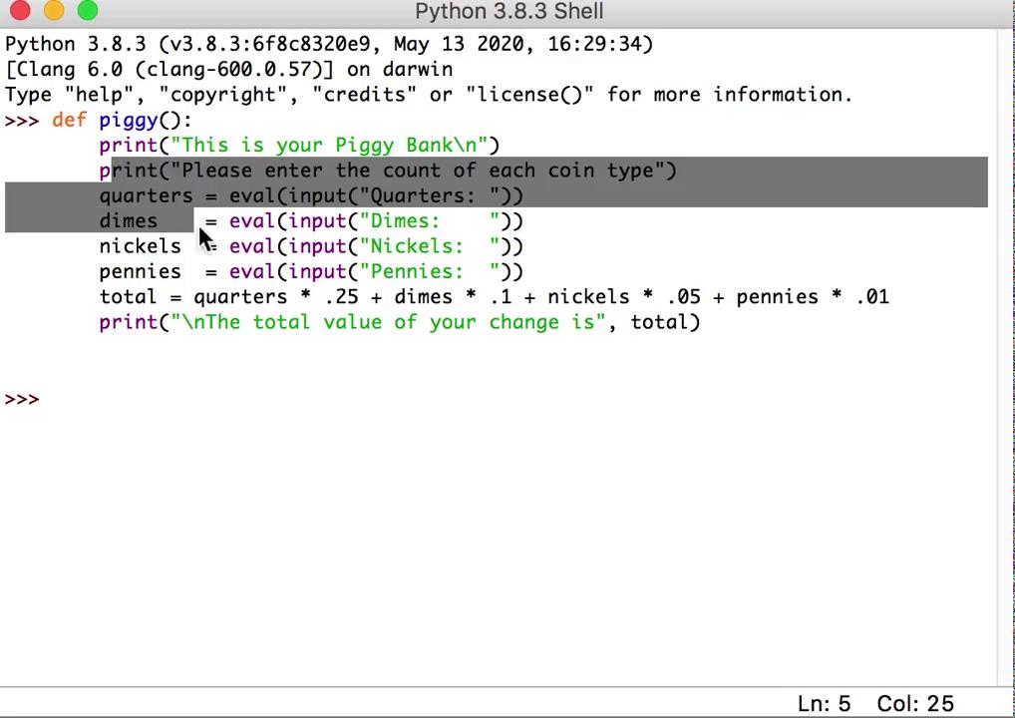
Piggy Bank Example v.1
Algorithm
Greets
Asks count of each coin
Sums up
Outputs the result

Slide 51
Dealing with Numbers
Pythagoras
500 B.C.
“οι αριθμοί κυβερνούν το σύμπαν”
Πυθαγόρας
(Numbers govern the universe.)

Slide 52
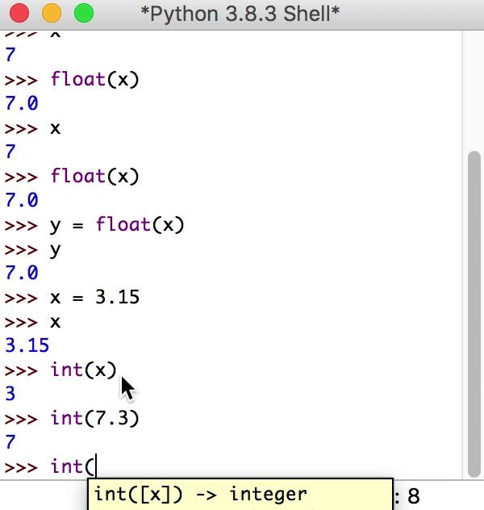
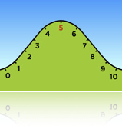
Type Conversion and Rounding
Standard float to int Conversions
Truncate - int(x)
7.3 becomes 7
7.8 becomes 7
Bankers Round - round(x)
7.3 becomes 7
7.8 becomes 8
7.5 becomes 8
8.5 becomes 8
9.5 becomes 10
Standard float or int to/from string conversions
str(x) - 135 becomes “135” - 3.15 becomes “3.15”
eval(s) - “135” becomes 135 - “3.15” becomes 3.15
int to float is available - float(x)
True Round - int(x+.5)
7.3 becomes 7
7.8 becomes 8
7.5 becomes 8
8.5 becomes 9
9.5 becomes 10

Slide 53
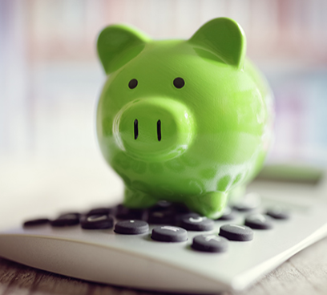
Piggy Bank Example v.2
Better Change Counter
Do a program that asks how many of each coin type you have and sum up how much dollars and cents you have
Algorithm
Greets
Asks count of each coin
Sums up
Outputs the result as, for example: 4 dollars and 21 cents instead of, for example: 4.21 dollars
Do it yourself now!

Slide 54
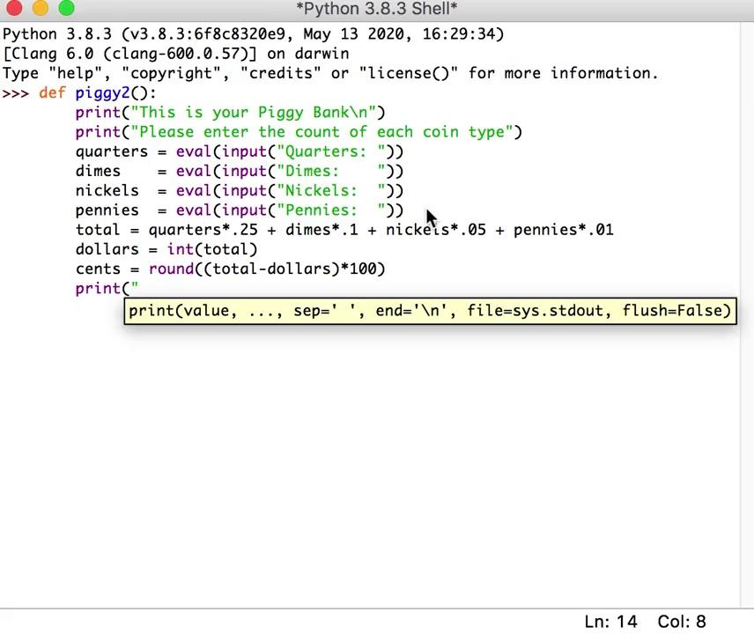
Piggy Bank Example v.2
Algorithm
...
Sums up
Get the dollars
Get the cents
Outputs the better result

Slide 55
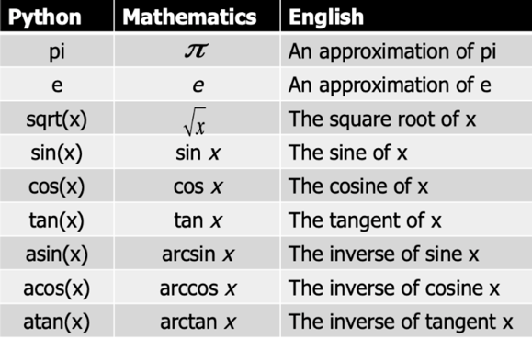
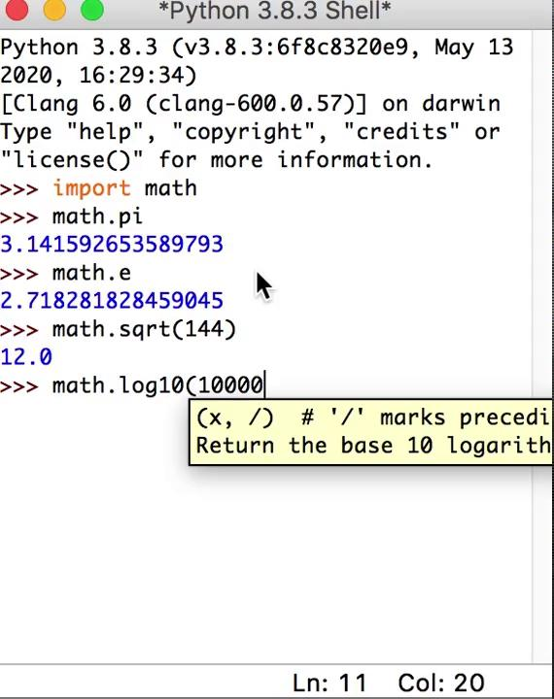
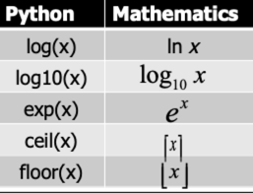
The math library
Full list at: https://docs.python.org/3/library/math.html
import math
from math import <item list>

